Slide 1
Drugs and hormones (they often go hand in hand…..)
Biology/Psychology 2606

Slide 2
Introduction
What is a drug?
Well, we all know what it means…
That ain’t good enough, we need some sort of definition
Alters physiology, but is not food…..
Vitamin C?
Some things are also poisons
Gasoline, mugwart..
Perhaps we don’t need a definition

Slide 3
Still….
What if you take it not to treat anything or to get high
Coke
Coffee
Beer
Frankly, an intuitive definition will have to do.

Slide 4
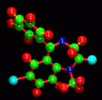
Names
Chemical Names
7-chloro-1,3-dihydro-1-methyl-5-phenyl-2H-1,4-benzodiazepin-2-one.
How very helpful….
Generic Names
diazepam
flouexitine
Trade Names
Valium
Prozac

Slide 5
Dosages
Different dosage sizes will have different effects on different people, animals.
Especially if they weigh different amounts
Standardize it
mg/kg

Slide 6
Dose Response Curves
Pick some variable for a response
Plot response as a function of dose
One drink and I am relaxed
4 drinks and I am tipsy
8 drinks and I am ‘relaxed’ again.
This shape is very common in DRCs

Slide 7
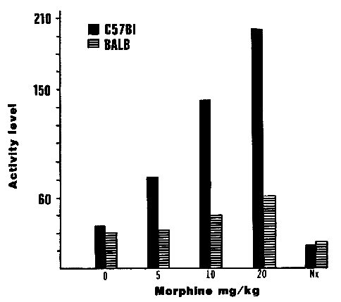
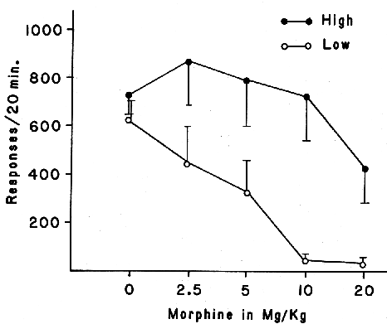
Dose Response Curves
Effect of morphine and morphine + naloxone on activity (left) and nosepoke (right) (Criswell, 1987)

Slide 8
Describing Effectiveness
ED₅₀ and LD₅₀
Effective dose for 50 percent of the population
subjective
Lethal dose for 50% of the population
Therapeutic Index (TI)
TI = LD₅₀ / ED₅₀
Higher the index, the safer the drug

Slide 9
Potency and Effectiveness or Efficacy
Find the ED₅₀ for both drugs
The one with the lower ED₅₀ is more potent
Efficacy is about the maximum amount of effect the drug will have
Morphine vs. aspirin

Slide 10
Some other key terms
Primary effects or main effects vs. side effects
Depends on your point of view
If you are taking morphine to deal with pain, the main effect is the analgesia and the (albeit fun) side effect is being high
If you are taking it because you want to groove to Quicksilver Messenger Service….

Slide 11
Key Terms, Continued
Agonists
Antagonists
Naloxone and opiates for example
Additive effects
Superadditive effects
Sleeping pills and martinis

Slide 12
Routes of Administration
If you are injecting, you need a vehicle
Saline
Subcutaneous
Slowest absorption
Intramuscular
Intraperitoneal
Intravenous
intraventricular

Slide 13
Routes…
Get into bloodstream via diffusion
(except IV injections obviously)
Inhalation works the same way
Gasses or solids
Orally, depends on lipid solubility
More soluble the easier the absorption
Ionized molecules are not absorbed
Rate is constant

Slide 14
Distribution and Metabolism
Once absorbed, the drug has to get past the blood brain barrier
Get across the membrane through passive or active transport
Protein binding stops some
Taken out of blood stream by kidneys, liver
Measured in half life

Slide 15
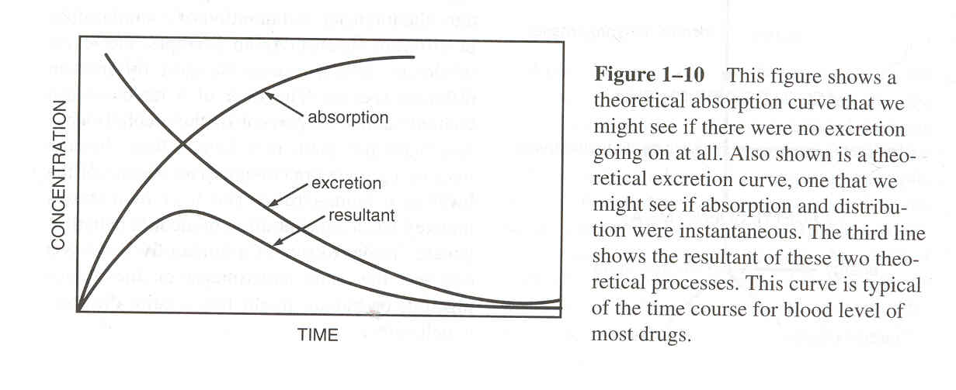
What affects metabolism?
Age
Sex
Species
Enzyme induction
Enzyme depression
Putting absorption and excretion together, you get the time course of the drug

Slide 16
Therapeutic window
You want to maintain enough of the drug in the system
Easy if the drug has a long time course
Harder if the time course is shorter

Slide 17
Drug taking
When people first thought about it (and until relatively recently) drug taking behaviour just seemed odd
Not avoiding pain
Doesn’t affect all people the same way
You don’t ‘need’ it
Aha! You must be an immoral pig, probably with little willpower. You are a bad person you junkie lowlife

Slide 18
The Disease Model
Oh perhaps it is not a problem with your character or morality
Ahh, yes, it is a disease
Or a disorder as we say today
Started with alcoholism
What is the disease mechanism?
But it is genetic!
So what

Slide 19
Physical Dependence Model
Withdrawal (from morphine) caused by ‘autotoxin’
Found to be lacking, but, the idea stuck.
Indeed, still VERY popular
Accounts for the ‘abnormality’ of it all
Can be combined with the disease model

Slide 20
Physical Dependence Model
Only Depressants?
Tatum and Seevers (1931) added habituation
Problem is, that stimulants, for the most part, don’t produce withdrawal symptoms
Hmm, Let’s invent a new idea!

Slide 21
Psychological Dependence
When you need a drug, but don’t need a drug
When you crave a drug
Circular
Biggest problems:
Continual abuse with drugs that do NOT produce withdrawal
Addiction without dependence

Slide 22
Positive Reinforcement Model
People used to think you couldn’t get animals addicted
Not moral
Can’t get the disease
Catheter
Work for drug
(Thompson and Shuster, 1964)

Slide 23
How does it work?
Seems circular, until you realize that we know what a reinforcer is not just from operational definition, but from physiology
Dopamine hypothesis
VTA -> MFB -> ACC
Morphine to PVG leads to dependence, to ACC, does not!

Slide 24
Animals and us aren’t so different after all….
Shuster’s other work
Rats will work for drugs not causing withdrawal
Rats will work for drugs without dependence!
Is hard to get them to take things orally though
Pickens and Thompson (1968) found that drug use follows the laws of learning!

Slide 25
So you are saying it is just conditioning?
Well, umm Yes
Explains the paradox of positive and negative effects of drugs
Choice in taking a drug depends on other available reinforcers
Hayman says it follows the matching law!

Slide 26
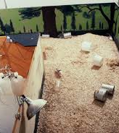
The Rat Park
Alexander’s work
Rats either in a standard cage on morphine
Or rats living in the rat park
Guess who stops doing morphine?

Slide 27
Classification of Drugs
Sedative hypnotics
Alcohol
Antipsychotics
Antidepressants
Narcotic analgesics
Psychomotor Stimulants
Nicotine
Caffeine
Hallucinogenics
weed

Slide 28
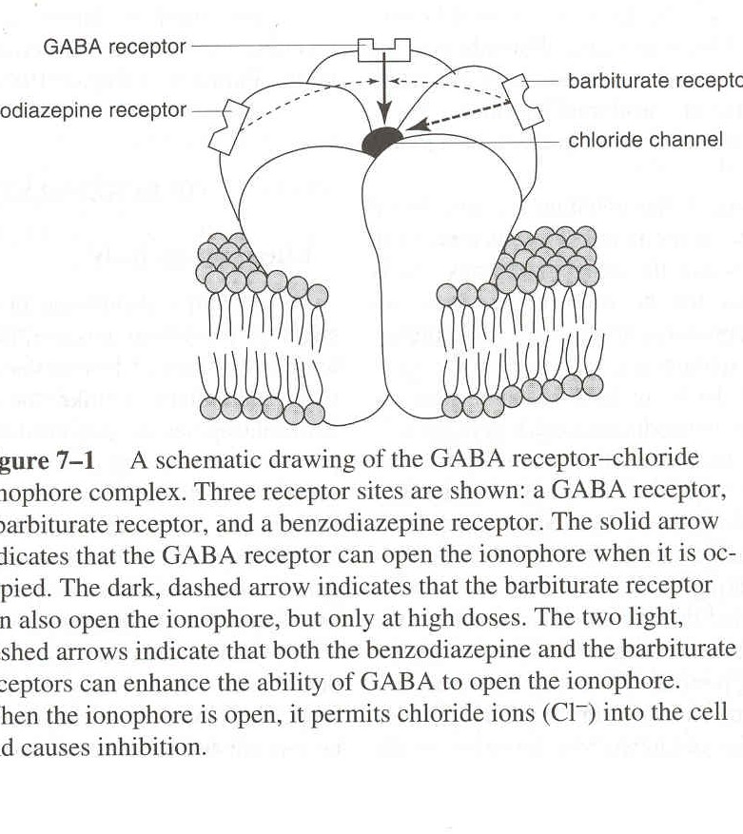
Sedatives work like this:
Modifies the effect of GABA
GABA lets Cl- in
Harder to fire
Positive GABA modulators
Make GABA more effective
Barbiturates can open ion channel all by themselves at higher levels

Slide 29
Beers and martinis
Still not that well understood
Depresses function of ion channel in glutamate receptors
After chronic use the brain sort of adjusts
Might be the cause of withdrawal symptoms
RO 15-4513 seems to be an alcohol antagonist

Slide 30
Antipsychotics
Block DA receptors
D2 especially
Direct relationship between effectiveness and D2 binding (r =1.00)
Also blocks Ach, 5Ht and H
Alters GABA, peptides
Blocks NE receptors, causes an increase in NE synthesis

Slide 31
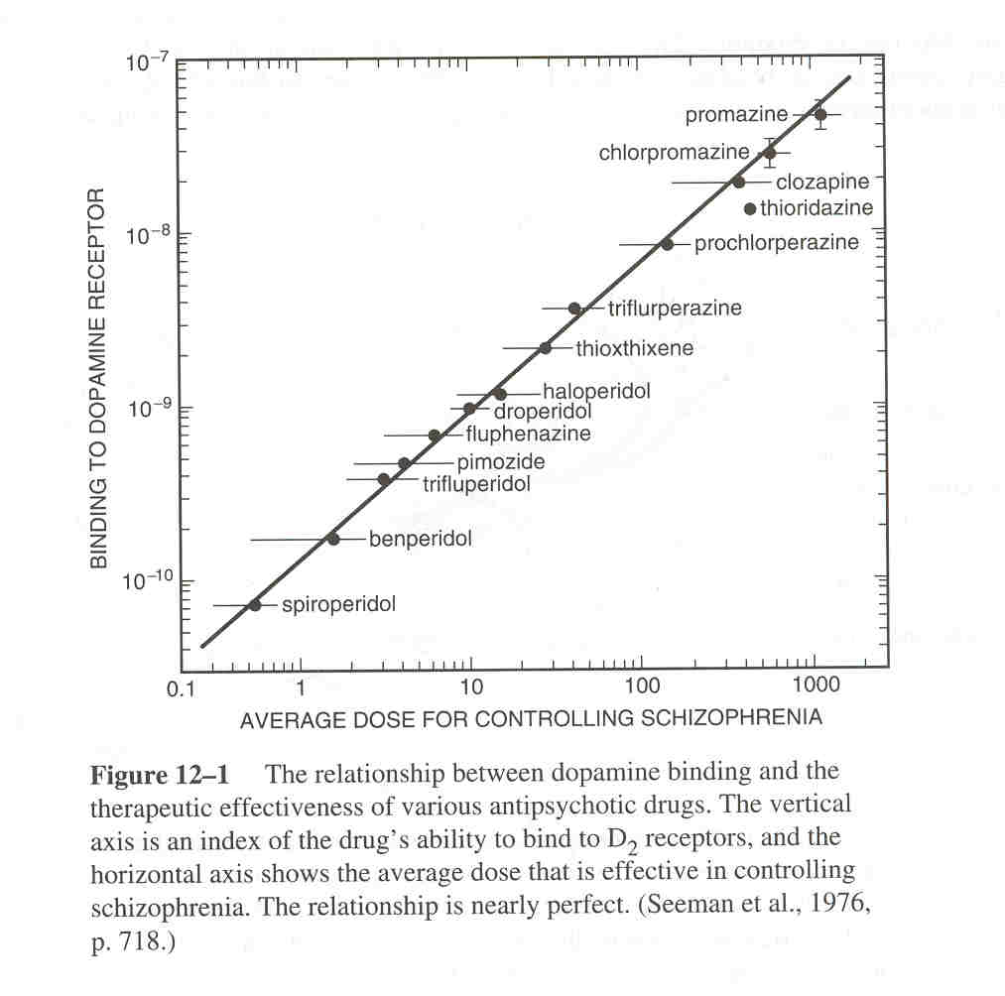

Slide 32
antipsychotics
Key brain regions:
Mesolimbic dopamine system
That’s the reward system
nigrostriatal
Could be the atypicals have less effect in this area (more DA here)
Drugs that block cholinergic receptors stop Parkinsonian symptoms, so do atypicals.

Slide 33
Antidepressants
MAOI obvious
TCA stop reuptake of monoamines
SSRI obvious
These effects are immediate, but the antidepressant effect is not, can take days or weeks even
Hmmmmmmmmm
How the hell does Li work?

Slide 34
Opiate Receptors
Three or four types
Mu
Throughout limbic system
HP and amygdila
Thalamus and locus coeruleus
Responsible for most interesting effects
Weak attraction = great effect

Slide 35
Opiate Receptors
Delta Receptor
Limbic system too, but do not overlap with mu
Cortex
Hypothalamus
Nucleus accumbens
Medulla
Many antipsychotic drugs work on delta receptors

Slide 36
Opiate Receptors
Kappa Receptor
Nucleus accumens
VTA
Hypothalamus
Thalamus
Sigma Receptor
Not just opioids
Psychotic symptoms

Slide 37
Opiate Receptors
Periaqueductal Grey area is full of opiate receptors
When in pain, these are stimulated
Amygdila
emotion
Respiratory, cough and vomit centres
REWARD SYTEM!!!!!!!
Well, there has to be some good reason to put a needle in your arm……….

Slide 38
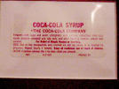
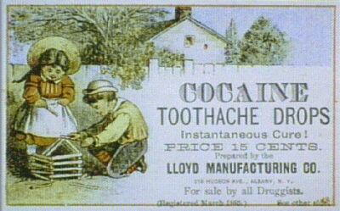
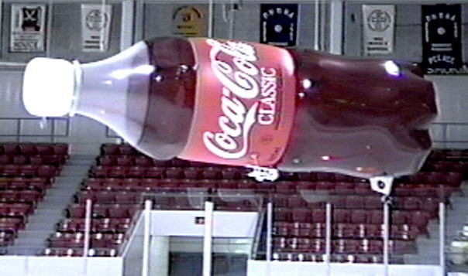
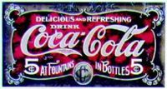
Coke adds Life, and a wicked High! The choice of a new generation!

Slide 39
Coke etc
Transmitter Leakage
CA + 5Ht
Increase in amount released
Ecstasy does this with 5Ht
Block reuptake
Coke does this only
In PNS E is released

Slide 40
Caffeine
Like alcohol, we don’t know!
Might block adenosine
Neuromodulator that inhibits firing
So, caffeine disinhibits?
High doses block benzodiazepine receptors

Slide 41
nicotine
There are nicotine receptors in:
Cortex
Basal ganglia
Ventral tegmental area
Nucleus accumbens
That’s the Reward system folks

Slide 42
Effects
PNS Effects
Tremors
Inhibition
Seems odd, disinhibition
Constriction of blood vessels
There are CNS effects too:
Reward system
Release of NE, E, DA 5Ht
Stimulant

Slide 43
You look cool and grown up if you smoke
If it is a stimulant, why do people smoke to relax?
Nesbitt’s Paradox
Physical act of smoking?
Withdrawal?
Could be due to nicotine receptors in GABA system

Slide 44
LSD and other 5Ht like drugs
About a 110 minute half life
Magic Mushrooms are similar
psilocybin
Timothy Leary started out with these, Tune In, Turn on, Drop out
Morning Glory Seeds
Harmine
Bufotenine (toad licking!)

Slide 45
NE and Ach like drugs and a few others….
MDMA
STP
Mescaline
Nutmeg!
Mandrake
Deadly nightshade
PCP (Angel Dust)
Special K

Slide 46
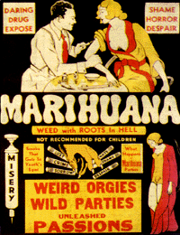
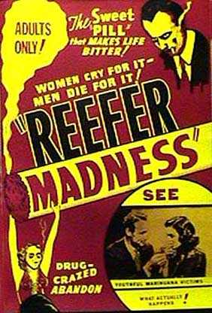

Slide 47
How do I know the red you see is the same as the red I see?
Radioactive Levonantradol
(syntehtic cannabinoid)
Group in the next lab found a gene that coded for a receptor site
The maps matched!
Science is cool

Slide 48
So, where are the receptors for THC?
Cortex
Hippocampus
Cerebellum
Basal ganglia
Spinal cord
Brainstem
Hypothalamus
Spleen!

Slide 49
Conclusions about drugs
Drugs are fun
Conditioning is a great explanation
Can you handle the truth?
Don’t mix science and morality

Slide 50
Hormones
Chemicals that target certain organs, and brain regions
Secreted by glands
Homeostasis
Reproduction
stress

Slide 51
Hypothalamus sends releasing factors to pituitary
Pituitary tells glands to make and release hormones
Hormones enter cells
Turn on genes
Proteins made

Slide 52
Let’s talk about sex
Hormones that is
Testosterone contributes to male spatial superiority on tests
Progesterone and estradiol, low levels, females do better on spatial tasks, higher levels, not so good, but verbal superiority shows up

Slide 53
I am so stressed
Brain recognizes stressor
Epinephrine and cortisol
One turns stuff on, one turns stuff off
Cortisol levels controlled by Hp
Too much damages Hp
So….

